Slide 1


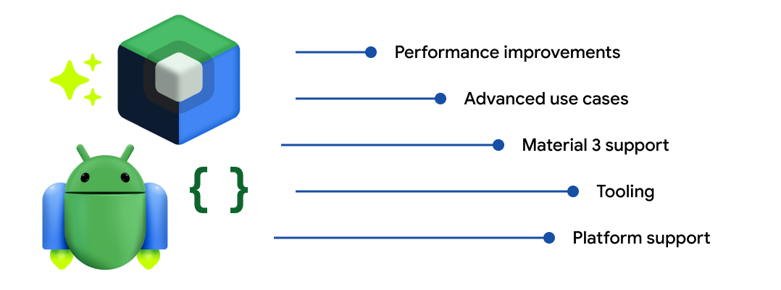

JETPACK COMPOSE
BY JIKSON JIMMY

Slide 2
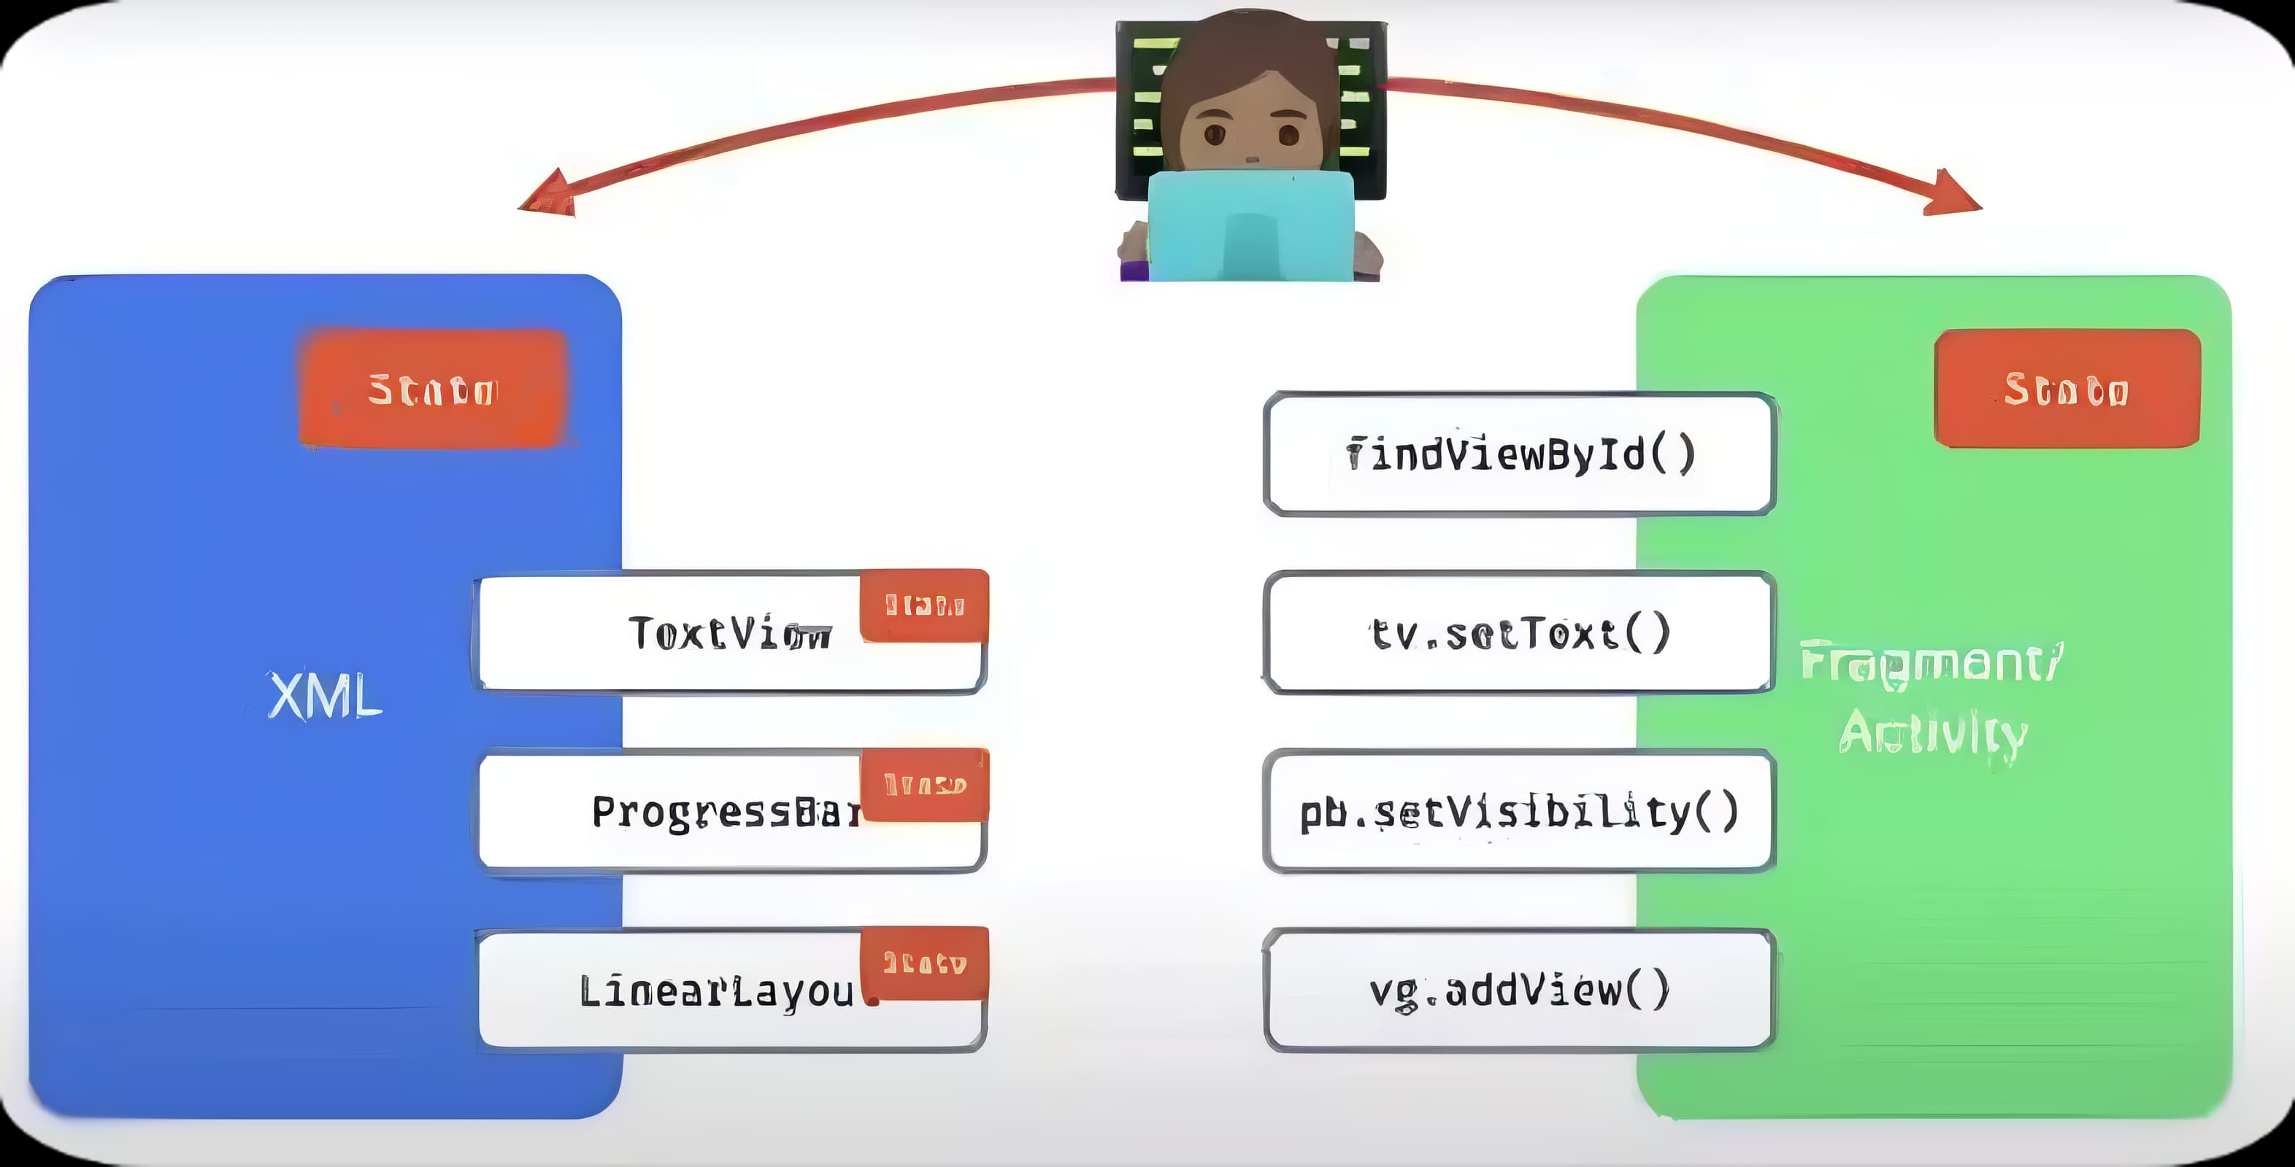
JETPACK COMPOSE
What is Jetpack Compose?
Jetpack Compose is a modern UI toolkit that is designed to simplify UI development in Android. It consists of a reactive programming model with conciseness and ease of Kotlin programming language. It is fully declarative so that you can describe your UI by calling some series of functions that will transform your data into a UI hierarchy.

Slide 3
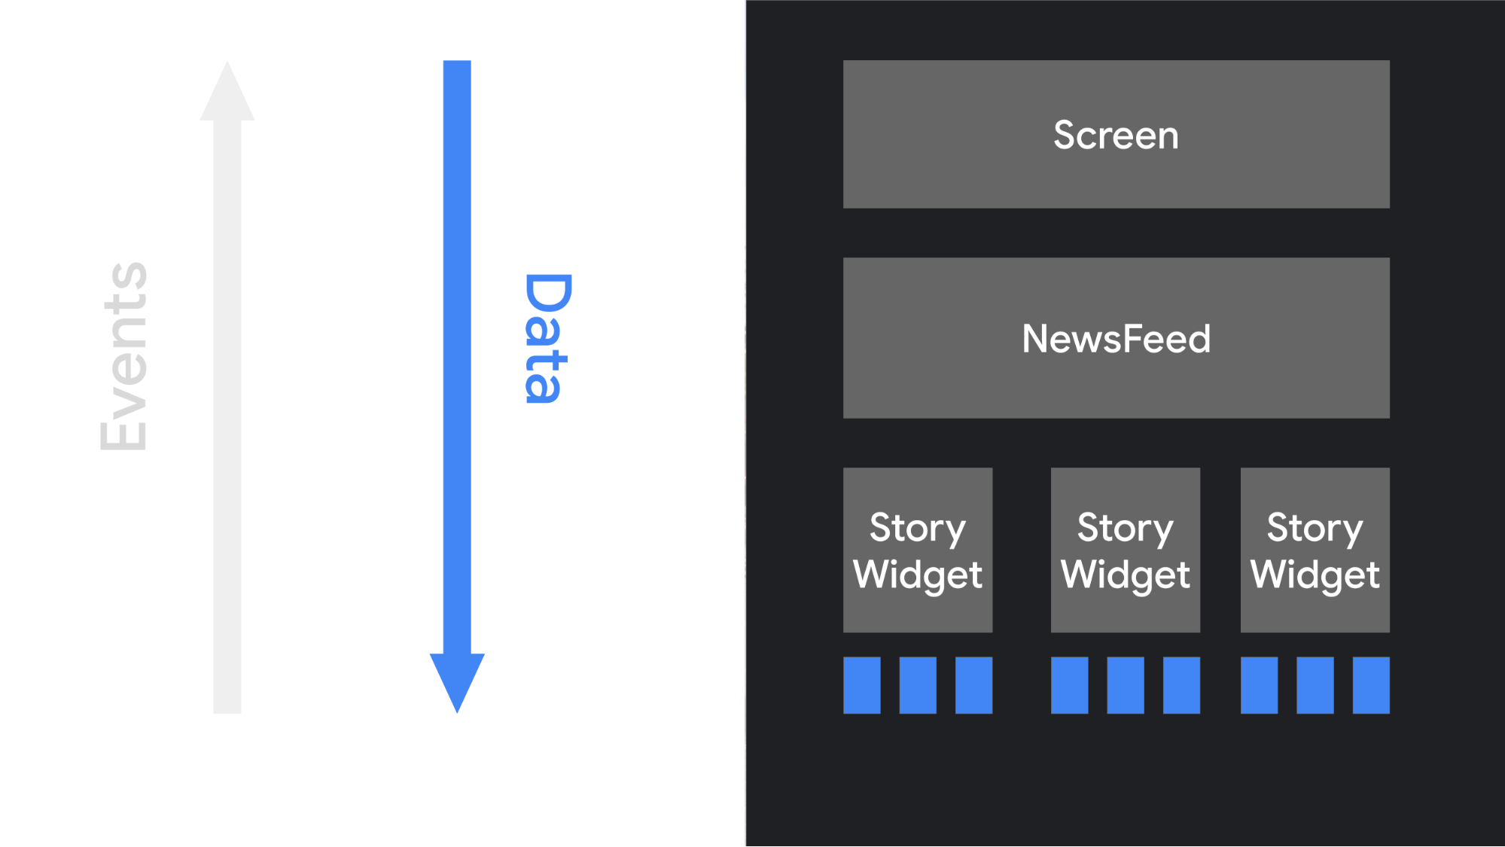
JETPACK COMPOSE
Benfits of Using Jetpack Compose
Declarative.
Compatible.
Increase development speed.
Concise and Idiomatic Kotlin.
Easy to maintain.
Written in Kotlin.

Slide 4
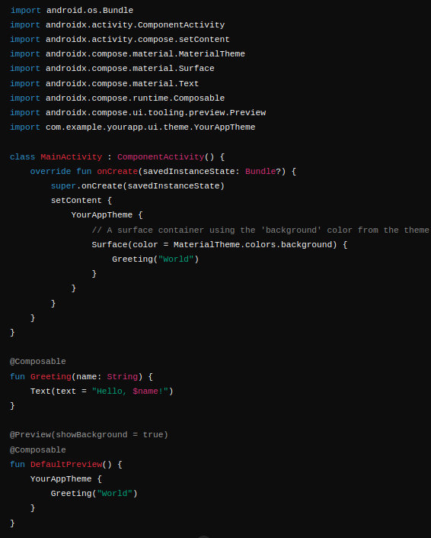

JETPACK COMPOSE
IMPERATIVE UI
DECLARTIVE UI

Slide 5
JETPACK COMPOSE
DECLARTIVE UI

Slide 6
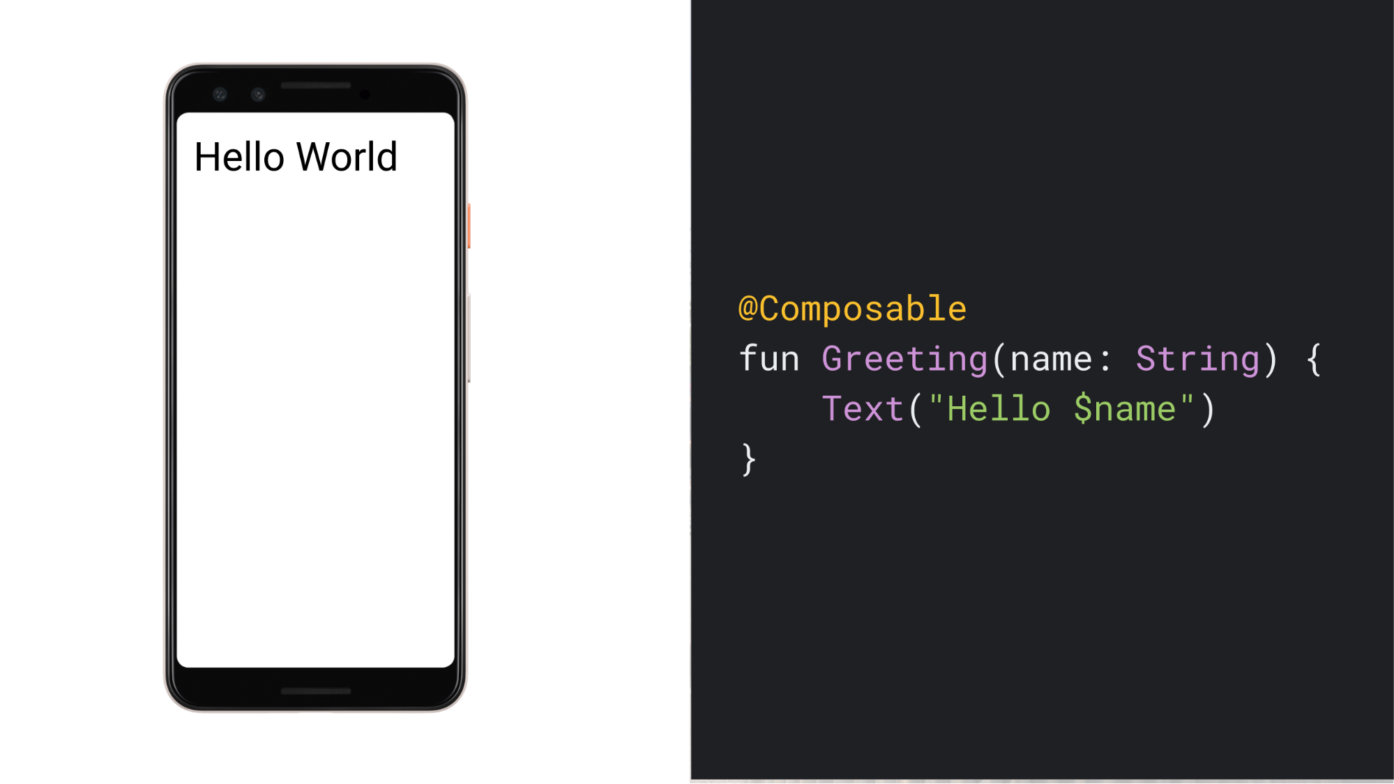
JETPACK COMPOSE
Composable Function...
The Jetpack Compose became Declarative due to Compose.....
Define your app's UI programmatically by describing how it should look and providing data dependencies, rather than focusing on the process of the UI's construction.

Slide 7
JETPACK COMPOSE
Composable Function...
A composable function is a special kind of function in Jetpack Compose, the modern UI toolkit for Android. Composable functions allow you to define your app's UI in a declarative way. Instead of defining the UI in XML files, you write functions that describe what the UI should look like based on the current state.
define a composable function by using the @Composable annotation.

Slide 8
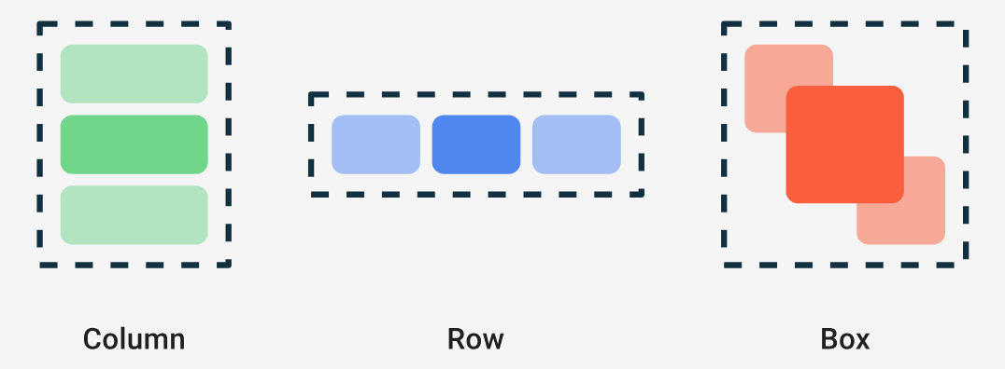
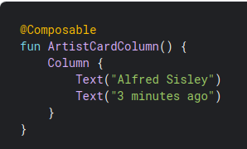

JETPACK COMPOSE
Composable Function...
Types of Composable

Slide 9
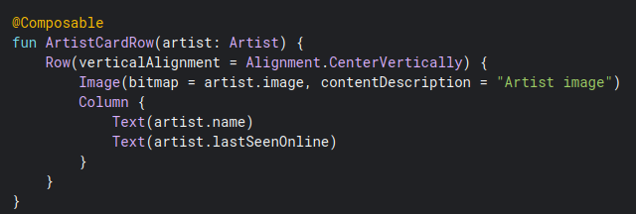

JETPACK COMPOSE
Composable Function
Column.....

Slide 10
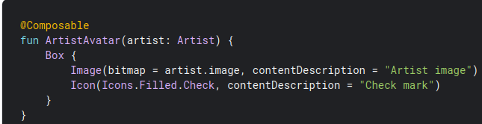
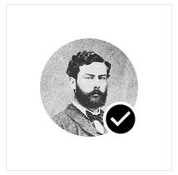
JETPACK COMPOSE
Composable Function
Row..

Slide 11
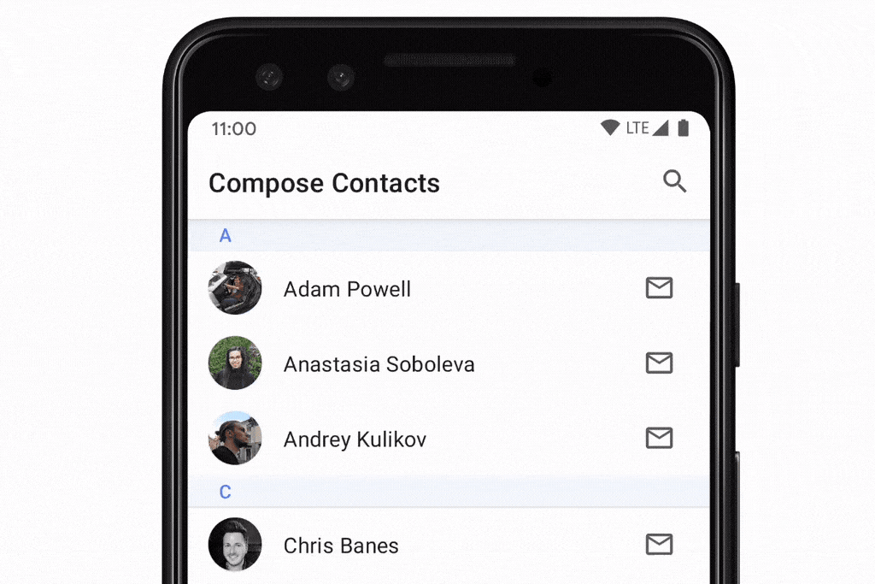
JETPACK COMPOSE
Composable Function
Box..

Slide 12
JETPACK COMPOSE
Composable Function
Lazy List...
This composable is equivalent to a recycler view in android’s view system. It is annotated with LazyColumn()..

Slide 13
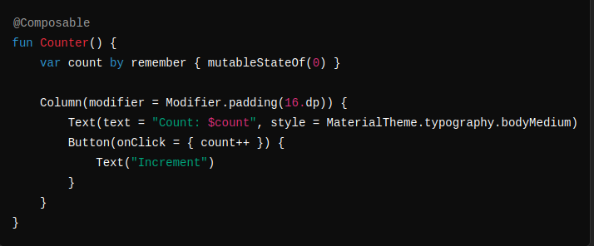
JETPACK COMPOSE
State in Compose....
managing state is crucial for creating dynamic and interactive user interfaces. Unlike traditional Android Views where state management might involve findViewById and manual updates, Compose leverages Kotlin's language features and functional programming principles to manage state declaratively and efficiently.

Slide 14
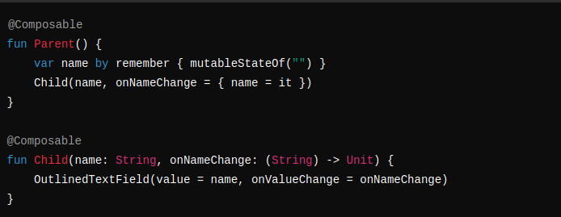
JETPACK COMPOSE
State in Compose....
Use mutableStateOf to create a mutable state.
remember keeps state across recompositions.
rememberSaveable keeps state across configuration changes.

Slide 15
JETPACK COMPOSE
State in Compose....
State Hoisting.
Parent manages the state.
Child receives state and event handler as parameters.

Slide 16

JETPACK COMPOSE
State in Compose....
Life Cycles.......
Activity Lifecycle:
onCreate,onStart,onResume,onPause,onStop,onDestroy.
Side effects.....
https://medium.com/@mortitech/exploring-side-effects-in-compose-f2e8a8da946b

Slide 17
JETPACK COMPOSE
State in Compose....
Navigation...
https://medium.com/@KaushalVasava/navigation-in-jetpack-compose-full-guide-beginner-to-advanced-950c1133740

Slide 18
JETPACK COMPOSE
THANK YOU

